Slide 1




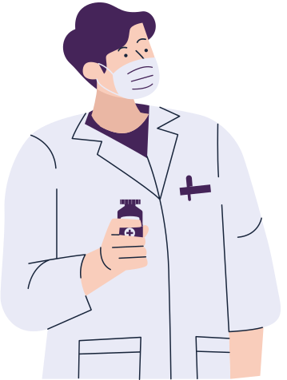



CM-GROUP 8
AI-Powered Radiology Assistant with CLIP Fine-Tuning, Contextual Chatbot, and FHIR Interoperability

Slide 2

Problem Statement
Radiological image interpretation is a complex, time-intensive task that requires expert analysis to detect subtle abnormalities. In many healthcare settings, especially in low-resource environments, there is a shortage of radiologists and inconsistent access to expert opinions.
This project addresses the challenge of automating preliminary radiological diagnosis and providing context-aware clinical assistance through an integrated AI system that combines image analysis, natural language processing, and medical data interoperability.

Slide 3
Background
Advances in multimodal AI models such as CLIP (Contrastive Language–Image Pre-training) have demonstrated the potential to connect visual understanding with natural language reasoning.
However, most existing radiology models:
Lack interpretability (black-box decisions),
Do not integrate contextual communication with users or clinicians,
Fail to link their findings to standardized healthcare data frameworks like FHIR (Fast Healthcare Interoperability Resources).

Slide 4
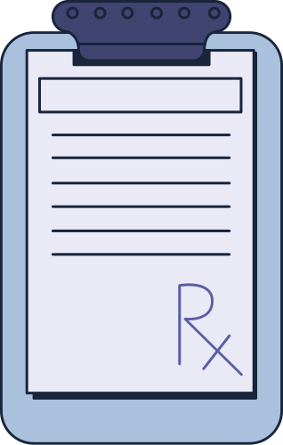
Hypothesis
If a multimodal AI model such as CLIP is fine-tuned on a radiological dataset and combined with a medical chatbot and structured reporting layer,
then it can:
Accurately identify abnormalities and associated organs from medical images,
Generate human-readable diagnostic summaries with confidence levels,
Provide context-aware, symptom-driven clinical guidance, and
Improve trust and interpretability through visual attention maps and structured reports.
Our project extends the use of CLIP into the medical domain by fine-tuning it on a radiology-specific dataset (images paired with descriptive question-answer pairs).

Slide 5
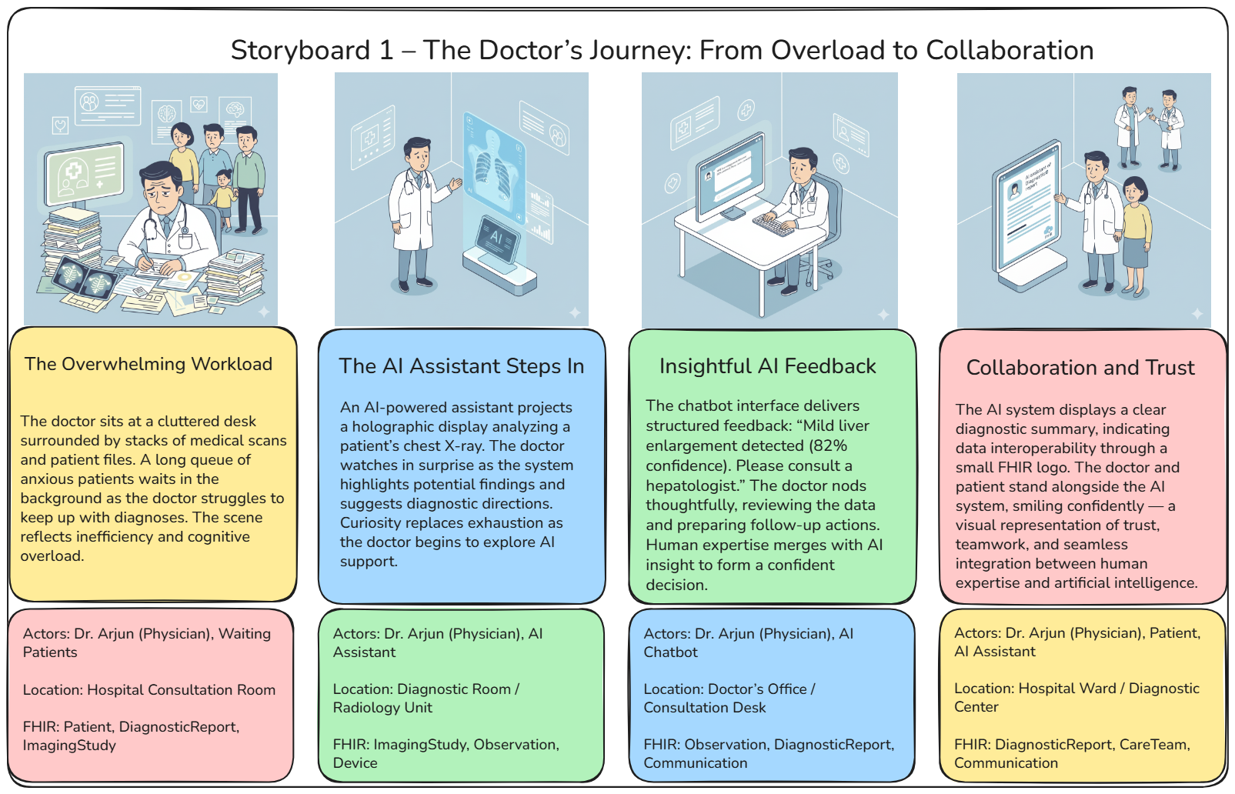

Slide 6
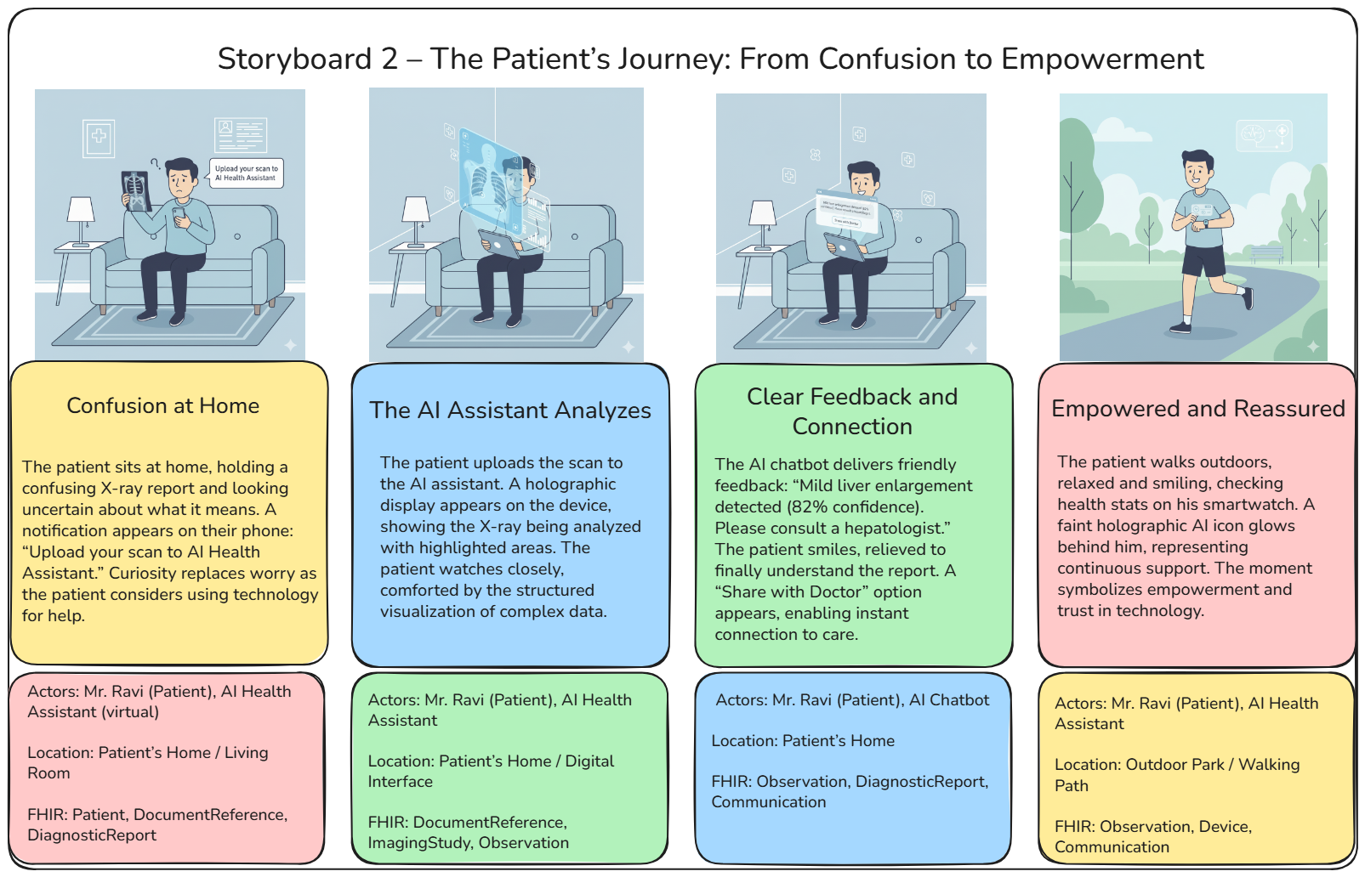

Slide 7
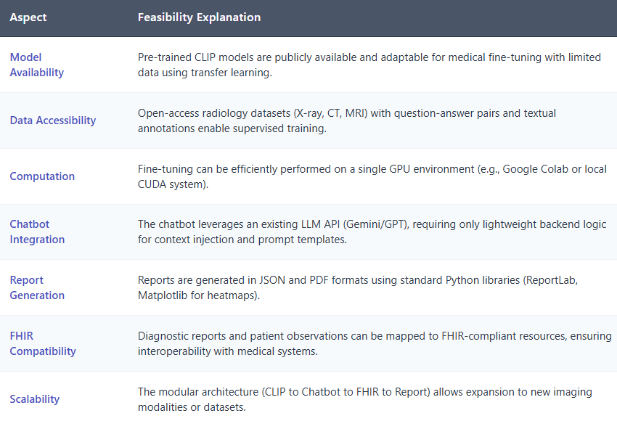
Feasibility
"Technical Feasibility Validated Across All System Components"
Our AI radiology assistant leverages existing technologies, open datasets, and standard healthcare protocols—making it ready for real-world deployment without requiring specialized infrastructure or experimental tools.
Project Readiness:
Uses publicly available pre-trained models
Trains on open-access medical datasets
Runs on standard GPU hardware
Integrates with existing hospital IT systems
Expandable to new imaging modalities

Slide 8
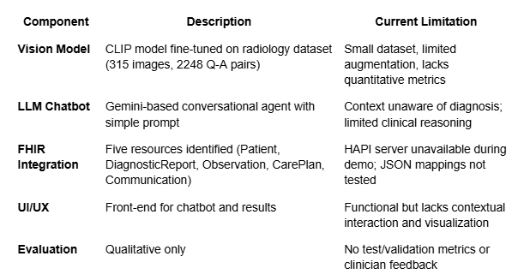
Current System Overview

Slide 9
CLIP Architecture in Medical Imaging
CLIP (Contrastive Language-Image Pretraining) is a multimodal model that learns to associate
images and text by training on image-caption pairs
Vision Encoder: ViT-B/32 (Vision Transformer) processes radiological images.
Text Encoder: Transformer-based model processes medical questions, captions, and answers.
During training, CLIP learns to align image embeddings with their corresponding text embeddings.
In our case, each radiology image is paired with a descriptive Q&A or caption, forming a supervised contrastive pair.
Dataset: 315 annotated images, 2,248 Q-A pairs.
Dual Encoder Setup
Contrastive Learning Objective
Fine-tuning strategy
Images resized and normalized.
Text cleaned, tokenized, and embedded.
rotation, brightness, contrast to enhance generalization.
The input image is encoded into a latent vector.
Candidate medical descriptions (conditions, organs) are encoded as text vectors.
Cosine similarity is computed between image and text vectors.
Top-matching text is selected as the predicted diagnosis.
Preprocessing & Augumentations
Inference Flow

Slide 10
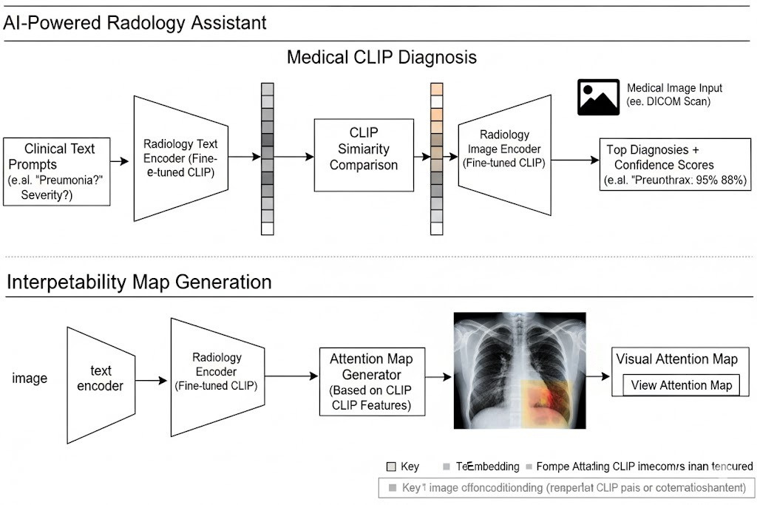
Workflow depiction of CLIP Architecture

Slide 11
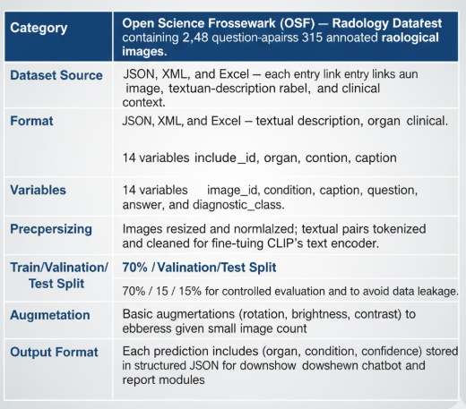
DATA

Slide 12
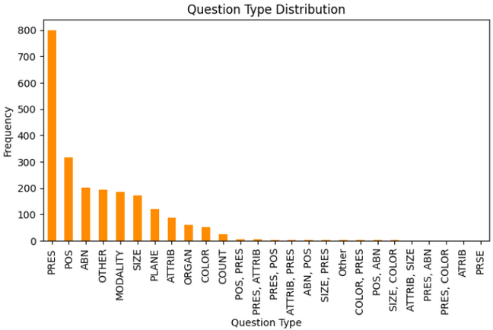
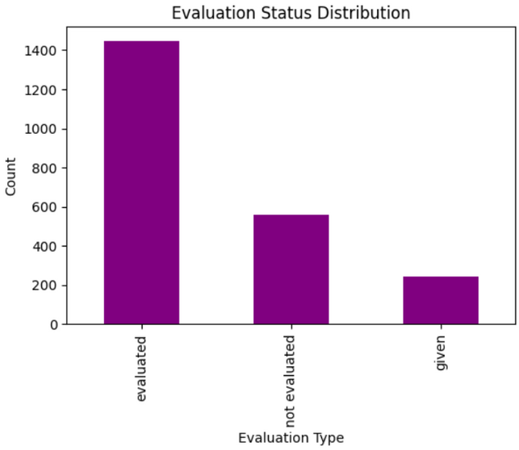
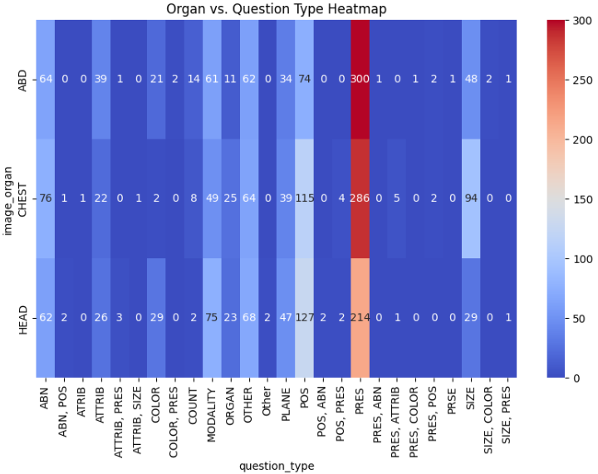
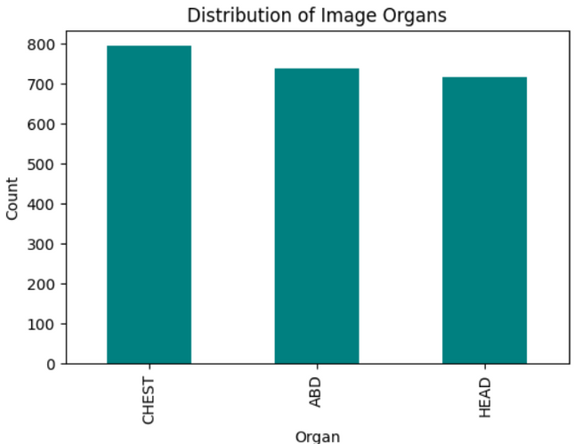
EDA
Unique Images: 314 Unique Question IDs: 2248
PRES - presence, POS - Position/Location, ABN - Abnormality, MODALITY - img Modality
Dataset Link - https://osf.io/89kps/overview
JSON Columns: ['qid', 'phrase_type', 'qid_linked_id', 'image_case_url', 'image_name', 'image_organ', 'evaluation', 'question', 'question_rephrase', 'question_relation', 'question_frame', 'question_type', 'answer', 'answer_type']

Slide 13
Phase 2 Expansion
Medical Chatbot Integration
Context-Aware Chat
Objective: Enable the chatbot to reference the model’s diagnostic output when responding to user queries.
Example Interaction:
User: What does my scan say?
Layer : Details
Input
Diagnosis summary JSON (organ, condition, confidence, risk level)
Prompt Template
"Given the diagnosis: {organ}-{condition}-{confidence}%, respond to user queries with contextual awareness and clinical neutrality."
Safety Layer
Force LLM to output informational, not prescriptive, responses. Example: append "Always advise user to consult a licensed clinician."
Output Example
"Based on your scan, mild hepatomegaly is possible. This can occur due to fatty liver, viral infection, or metabolic causes. Please consult a hepatologist."
Chatbot: The model indicates signs of an enlarged liver (hepatomegaly) with a confidence of 82%. Would you like to know possible causes or recommended tests?

Slide 14
Phase 2 Expansion
Medical Chatbot Integration
Context-Aware Chat
Objective: Enable the chatbot to reference the model’s diagnostic output when responding to user queries.
Example Interaction:
User: What does my scan say?
Layer : Details
Input
Diagnosis summary JSON (organ, condition, confidence, risk level)
Prompt Template
"Given the diagnosis: {organ}-{condition}-{confidence}%, respond to user queries with contextual awareness and clinical neutrality."
Safety Layer
Force LLM to output informational, not prescriptive, responses. Example: append "Always advise user to consult a licensed clinician."
Output Example
"Based on your scan, mild hepatomegaly is possible. This can occur due to fatty liver, viral infection, or metabolic causes. Please consult a hepatologist."
Chatbot: The model indicates signs of an enlarged liver (hepatomegaly) with a confidence of 82%. Would you like to know possible causes or recommended tests?

Slide 15
Phase 2 Expansion
Medical Chatbot Integration
Example Interaction:
Symptom-Based Diagnosis
Objective: Allow users to describe symptoms in natural language (e.g., “I feel breathless and dizzy”) → model suggests possible affected organs or next tests.
User: I have abdominal pain and yellowish eyes.
Chatbot: These symptoms may involve the liver or gallbladder. Recommended tests: Ultrasound Abdomen, Liver Function Test (LFT).
PIPELINE
Text Input → LLM Symptom Parser: Extract medical entities and symptoms.
Symptom-to-Organ Mapper: Use medical ontology (e.g., UMLS, SNOMED CT) to map symptoms to organ systems.
Organ-to-Test Suggestion: Suggest possible radiological or lab tests.

Slide 16
Phase 2 Expansion
Medical Chatbot Integration
Example Interaction:
Input
Organ: LungsCondition: Pneumonia (Confidence: 88%)
Follow-up Recommendations
Objective: Generate action-oriented but safe next-step suggestions based on model output and chat context.
“You may have signs of pneumonia. Please consult a pulmonologist and get a chest X-ray or CT follow-up within 2–3 days.”
Implementation:
Input
Organ: BrainCondition: Lesion (Confidence: 61%)
Define rule-based templates linked to diagnosis categories.
LLM reformulates them conversationally.
Ensure every recommendation ends with safety reminder (“Consult a doctor before taking action”).
“A possible abnormality was noted in the brain scan. Consider MRI Brain with contrast and a neurologist’s evaluation.”

Slide 17
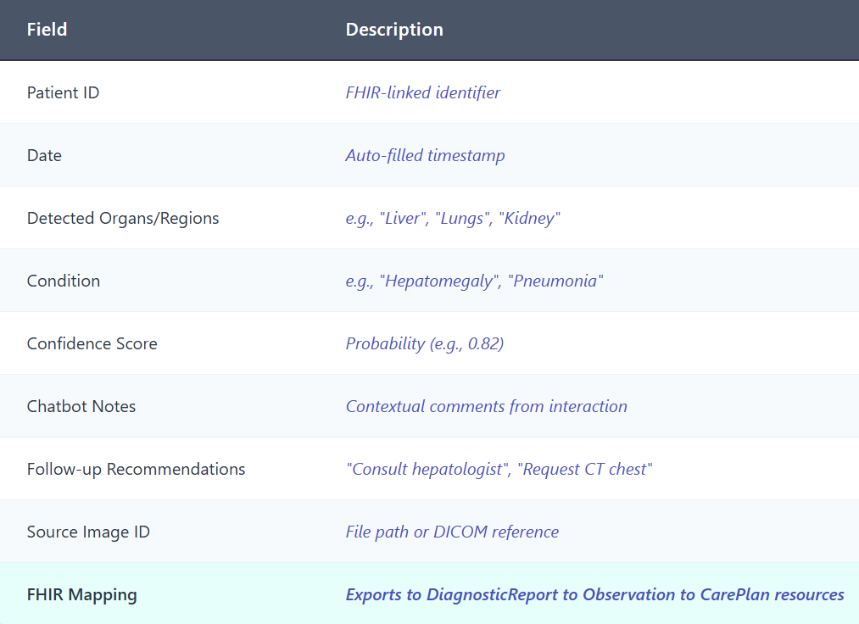
Report Generation Module
Sample Output (JSON):
Automated Diagnosis Report
A structured, machine-generated diagnostic report summarizing model outputs and chatbot findings.
{
"Patient_ID": "PAT12345",
"Report_Date": "2025-10-12",
"Findings": [
{
"Organ": "Liver",
"Condition": "Hepatomegaly",
"Confidence": 0.82,
"Recommendation": "Consult hepatologist; perform Liver Function Test."
}
],
"Chatbot_Notes": "Patient asked about possible causes and was advised to see a specialist.",
"FHIR_Link": "DiagnosticReport/DR12345"
}
Schema:

Slide 18
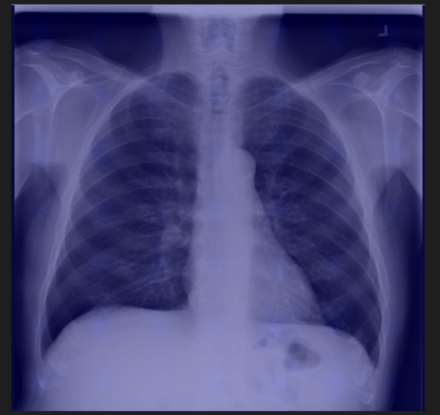
Why Normal CLIP Failed on Radiology Images
Observed Issue: Poor & Faint Heatmaps
During initial testing, the attention heatmaps generated by pretrained CLIP were extremely faint, unfocused, and inconsistent. No region showed strong activation, and the patterns appeared random and blurry.
Reason for Failure
Normal CLIP was trained on internet images, not medical images. Therefore:
It has no understanding of radiology concepts like consolidation, pneumothorax, effusion, or opacity.
It attends to irrelevant features such as bones, edges, and image brightness.
Its similarity scores are weak and random, making it unsuitable for medical diagnosis.
This proves that general-domain CLIP cannot directly support a medical VQA chatbot.

Slide 19
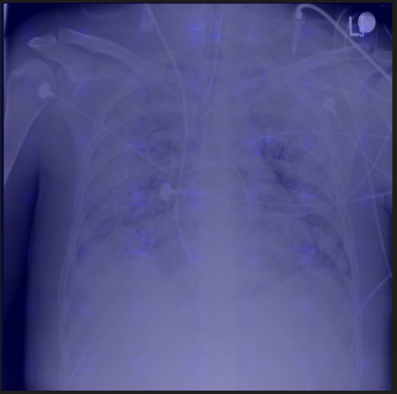
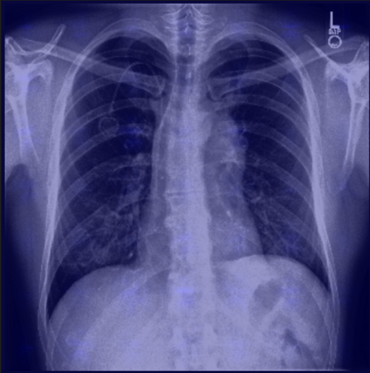
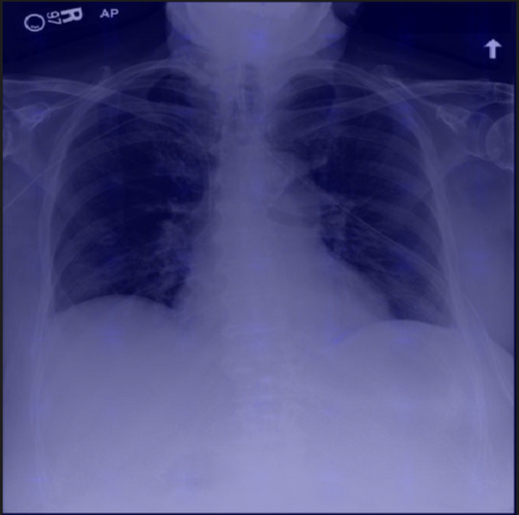
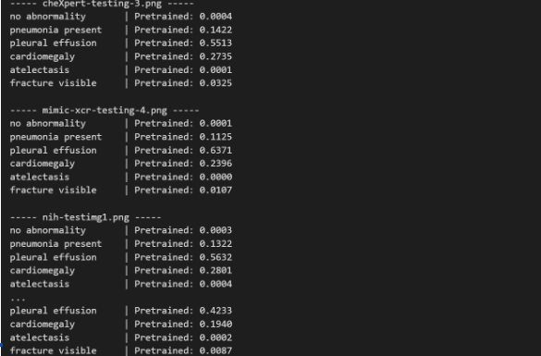
More
heatmaps:
Weak probability scores and diffused heatmaps from Normal CLIP showed that it has very limited medical understanding.
Heatmaps showing where the normal clip model focused on these dataset samples without any domain knowledge base, like finetuned clip:

Slide 20
Importance of Fine-Tuning CLIP on VQA-RAD
Fine-tuning CLIP on VQA-RAD was essential because it enabled the model to learn:
Actual radiology semantics (e.g., brain infarct, hepatomegaly, pneumonia).
Meaningful similarity scores during retrieval.
Clinically relevant attention instead of random heatmaps.
Correct image–text alignment needed for VQA.
Reliable chatbot responses using knowledge grounded in real medical images.
After fine-tuning:
Heatmaps became sharper and focused on diagnostic regions.
Retrieval accuracy improved significantly.
Model behaviour became interpretable and clinically meaningful.
This fine-tuning step transformed CLIP from a general vision-language model into a medical-aware VQA system.

Slide 21
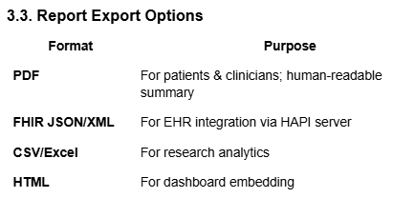
Report Generation Module
Visual Explanation (Attention Heatmaps)
Goal: Improve clinical trust and explainability using visual overlays showing the regions influencing the model’s prediction.
Approach:
Use Grad-CAM or Attention Rollout on the CLIP vision encoder.
Overlay heatmap on original scan (normalized intensity).
Store both raw and overlay images in output folder /reports/heatmaps/.
Display Example:
Input: liver_scan_001.png
Output: heatmap_liver_scan_001.png
UI Integration:
Add a “View Attention Map” button next to each prediction.
Tooltip: “Highlights areas that most influenced the diagnosis.

Slide 22
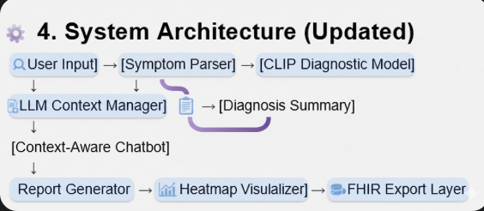

Slide 23
RESULTS

Slide 24
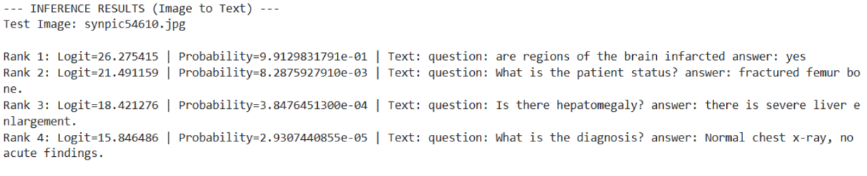
Custom Dataset & Processing
RadiologyClipDataset loads preprocessed image tensors and builds “question: <q> answer: <a>” text.
CLIP tokenizer used for text; custom collate function for batching.
Model & Training Setup
Base model: openai/clip-vit-base-patch32 (processor + CLIPModel).
All parameters fine-tuned with AdamW (LR = 5e-6).
Mixed precision training (autocast + GradScaler).
Objective: CLIP contrastive loss (image ↔ text alignment).
Training Results
Dataset: VQA-RAD (2248 samples; 90/10 split).
Loss decreased across epochs: 2.89 → 2.22 → 1.54, indicating strong image–text alignment.
Inference Pipeline
Load test sample (image + Q/A) from vqa_rad_clean.csv.
Load preprocessed image tensor + fine-tuned model (epoch3).
Create candidate texts: 1 correct + 3 distractors.
Compute CLIP similarities → softmax → rank QA options.

Slide 25
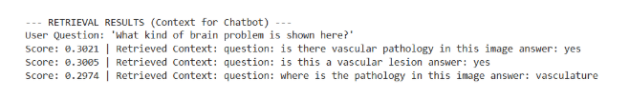
Image-to-Text Retrieval: Working and Testing Summary
The image-to-text retrieval module identifies the most relevant medical Q&A entries for a given image by comparing the image’s visual embedding with the text embeddings stored in the knowledge base.
The process begins with validating the required inputs, ensuring that both the knowledge base and the pre-processed image tensor are available.
Once validated, the system loads the image tensor and encodes it using CLIP’s image encoder, generating a normalised image embedding in the shared image text space.
This embedding is then compared with every Q&A embedding using cosine similarity, allowing the model to measure how closely each text entry aligns with the visual content of the input image.
After computing these similarities, the system sorts the scores and extracts the top-K Q&A pairs that best match the image.
For testing,
We use a sample image such as synpic54610.jpg along with a user query like “What kind of brain problem is shown here?”.
The retrieval system then returns the top-3 most similar Q&A pairs from the knowledge base.
Each result includes the user question guiding the retrieval, the similarity score indicating how strongly the Q&A pair matches the image, and the retrieved context containing the actual Q&A text.
Together, these elements demonstrate how effectively the model links visual medical information with the relevant textual knowledge stored in the system.

Slide 26
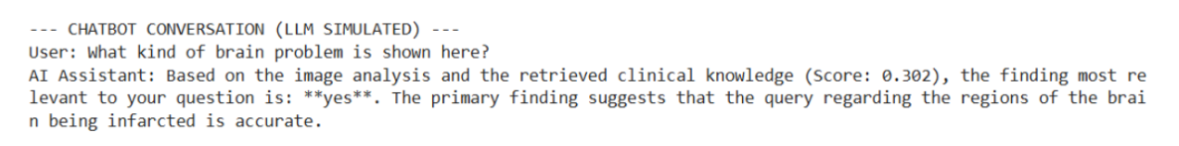
LLM-Simulated Chatbot Response Generation
The chatbot module takes the user’s question and the retrieved contexts produced by the image-to-text retrieval system and generates a natural, conversational response.
It begins by receiving two inputs: the user_question, which contains the query about the medical image, and the retrieved_context, which holds a list of text score pairs ranked by similarity.
From this list, the system selects the most relevant entry, specifically the first element,
Because it carries the highest similarity score and therefore provides the most trustworthy clinical information
This selected text is then processed by splitting it, allowing the system to isolate the actual medical answer from the question part.
After cleaning the extracted answer using trimming operations, the module constructs a simulated LLM reply. The response template integrates the primary finding, its corresponding similarity score, and a brief explanation that describes why this finding is relevant to the user’s original question.
Finally, the system prints the conversation, showing both the user’s question and the AI-generated reply.
This creates a realistic Visual Question Answering interaction where the assistant explains the most clinically meaningful result derived from retrieval.

Slide 27
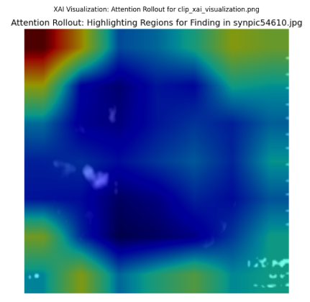
XAI Visualization: Attention Rollout Summary
This module generates interpretability heatmaps that show which parts of a medical image contribute most to the CLIP model’s decision.
The process begins with a configuration stage where paths for the fine-tuned model, processed images, and output directory are defined, along with automatic device selection and a global structure to store attention weights.
Once the model is loaded, forward hooks are registered on every self-attention block inside the vision encoder, allowing all attention matrices to be captured during inference.
When an image is passed through the model, the system performs “attention rollout,” an explainability method that fuses attention heads, injects residual connections, and propagates attention scores across layers.
The resulting attention mask is reshaped, normalised, and upsampled to match the original 224×224 resolution of the image.
Finally, the visualisation component overlays this heatmap onto the original image, producing a clear diagnostic map where red and yellow regions indicate areas that the model relied on most.
This helps clinicians and researchers understand model reasoning and validate whether the network is focusing on medically meaningful structures.

Slide 28
Chain of thoughts- Exaplainability
This is the Chain of Thought (CoT) output, which is the detailed textual reasoning behind the chatbot’s diagnosis.
It provides immediate transparency by showing you the model’s top diagnostic candidates—the different Ranks—along with the corresponding probability for each.
The system focuses on the most probable finding, but we always present a calibrated confidence score to ensure you understand the model's certainty, preventing over-reliance.
Critically, the 'Uncertainties/Limitations' and 'Safe Next Steps' sections are a built-in safety layer, reminding users that this is decision support, not a final clinical verdict.
The CoT transforms the AI from a black box into a collaborative assistant, allowing you to validate the system's logic against your own clinical knowledge.
--- INFERENCE RESULTS (Image to Text) ---
Rank 1: Text=question: are regions of the brain infarcted answer: yes | Prob=0.9998544454574585
Rank 2: Text=question: Is there hepatomegaly? answer: there is severe liver enlargement. | Prob=0.00010214199573965743
Rank 3: Text=question: What is the patient status? answer: fractured femur bone. | Prob=4.253528459230438e-05
Rank 4: Text=question: What is the diagnosis? answer: Normal chest x-ray, no acute findings. | Prob=8.991993354356964e-07
--- EXPLAINABLE CHATBOT RESPONSE (HIDDEN CoT) ---
Result summary:
The model's top finding suggests: yes.
Model Confidence: 63.1% (calibrated, capped at 95%)
Uncertainties / Limitations:
- Top finding is notably stronger than alternatives.
Safe next steps:
- Discuss these findings with a licensed clinician for clinical correlation.
- If clinically indicated, consider follow-up imaging or targeted tests per physician's advice.
This information is for educational purposes only and does not replace professional medical advice.

Slide 29
Report Generation Module
1. CLIP Model–Based Finding Extraction
The CLIP model generates the primary clinical finding from the input image.
Example output: “answer: cerebral infarction”
2. Automated NLP Mapping to SNOMED CT
The extracted finding is passed into a simulated NLP pipeline.
The function hf_ner_to_snomed_mapping():
reads the medical text,
identifies the relevant clinical terminology (e.g., “infarction”),
maps it automatically to the appropriate SNOMED CT concept.
Example mapping returned:
System: SNOMED CT
Code: 420000003
Meaning: Cerebral Infarction (finding)
This mechanism replaces manual conditional rules.
3. FHIR DiagnosticReport Construction
The function generate_fhir_diagnostic_report_nlp() constructs a valid FHIR DiagnosticReport in JSON format.
The report includes:
patient demographic information,
report status set to final,
LOINC code representing MRI Brain,
NLP-extracted clinical finding,
mapped SNOMED CT code,
AI-generated confidence score,
reference to the analyzed image.
4. Output Generation
The system prints:
the mapped SNOMED CT code, and
the complete FHIR DiagnosticReport in clean JSON format.

Slide 30
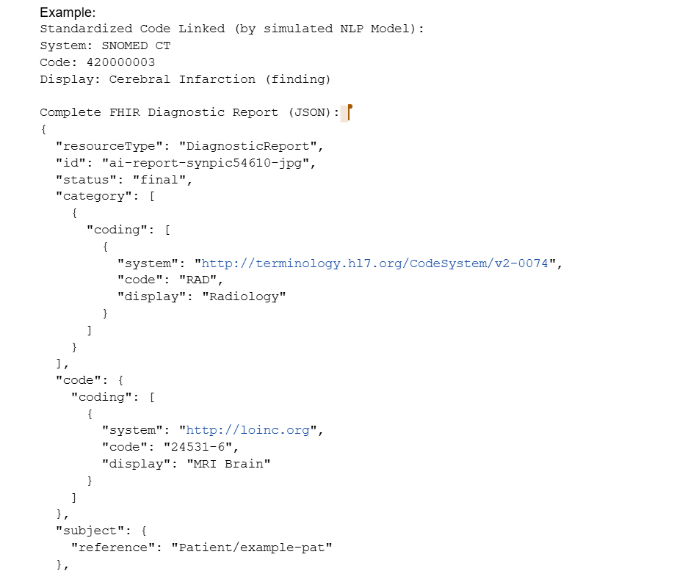
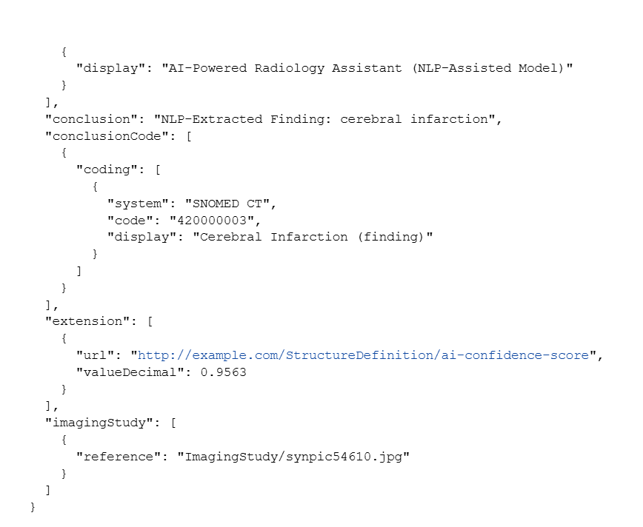

Slide 31
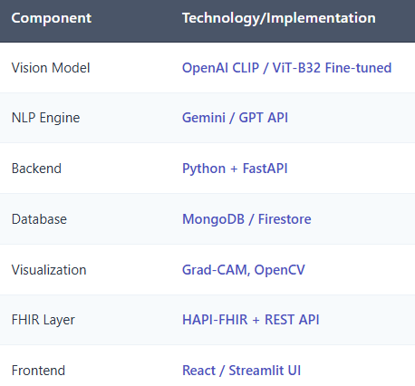
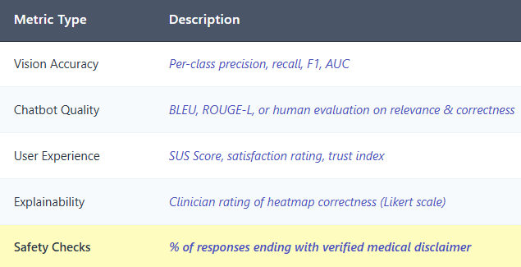
"Robust Technology Foundation + Comprehensive Validation”
Our system is built on proven technologies and evaluated through rigorous clinical standards to ensure accuracy, safety, and real-world usability before deployment.
Technology Stack :
Evaluation Strategy :

Slide 32
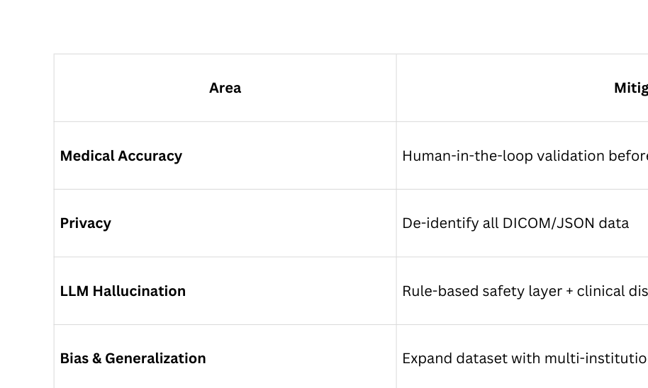
Ethical, Safety & Compliance Checklist
This checklist ensures that our AI system adheres to the highest standards of ethics, safety, and compliance in healthcare applications. Each area focuses on reducing potential risks from ensuring medical accuracy through expert validation, to protecting patient privacy by removing identifiable data. Measures like rule-based safety layers minimize AI hallucinations, while diverse datasets enhance fairness and generalization. Finally, strict alignment with FHIR, HIPAA, and CDS guidelines guarantees full regulatory compliance and trustworthy system performance.

Slide 33
REFERENCES
“Artificial intelligence in medical imaging - Pesapane et al. (2018)”. This paper examines how medical image interpretation evolves from a purely sensory skill to more time-intensive tasks. SpringerOpen
“The role of AI in mitigating the impact of radiologist shortages - Achour et al. (2025)”. Focuses on the global radiologist shortage and how AI helps address it. SpringerLink
“Shedding light on AI in radiology: A systematic review and meta‑analysis - Neves et al. (2024)”. Emphasises the complexity of radiological image interpretation and how AI is used. sciencedirect.com
“AI solutions to the radiology workforce shortage - Jing (2025)”. It's about how AI can help with radiologist scarcity. Nature
“Re‐defining Radiology Quality Assurance (QA) - Wismueller et al. (2022)”. Discusses hybrid AI systems that combine imaging and NLP for workflow. arXiv
“CLIP Model Overview” - link

Slide 34
TEAM MEMBERS
Nikhil kumar 2022322 : Problem Statement & StoryBoard & Chatbot dev
Aditya kumar Sinha 2022034: Hypothesis & EDA
Harsh Vishwakarma 2022205: Dataset PreProcessing and fine tuning
Pandillapelly Harshvardhini 2022345: EDA
Niteen Kumar 2022336: Extending to Chatbot Integration
Tanmay Khatri 2022534: Phase two expansion,safety and compliance checklist
Rounak Dey 2023449: Slide Preparation & Documentation
Aryan Rishi 2023146: Building upon CLIP Architecture and its workflow
Divyank 2023206: Model Deployment Strategy & API Development
Shivam 2022477: Content Review & EDA
Pranjal Bharti 2021080 : User Interface (UI) / User Experience (UX) Design & Development

Slide 35

Thank you for your attention

